Slide 1
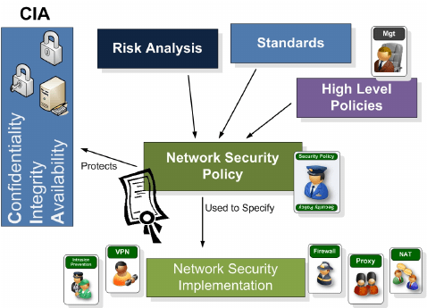
Network Security Policies and Procedures

Slide 2
Contents:
Objectives
Network Security Policy
Sample of Network Security Policy
Network Perimeter Security
Network Monitoring and Logging
Patch Management
Physical Security
John the Ripper

Slide 3
Objectives:
Understanding the importance of network security: Students should learn about the significance of network security in protecting an organization's sensitive data, intellectual property, and resources.
Knowledge of security policies and procedures: Students should gain a comprehensive understanding of various network security policies and procedures, including access control, authentication, encryption, incident response, and disaster recovery.
Ability to analyze and assess security risks: Students should develop skills to identify potential security risks and vulnerabilities within a network infrastructure, and evaluate the potential impact and likelihood of these risks.
Proficiency in implementing security controls: Students should learn about different security controls, such as firewalls, Intrusion Detection Systems (IDS), Intrusion Prevention Systems (IPS), and Virtual Private Networks (VPNs). They should be able to implement and configure these controls effectively.
Familiarity with compliance and legal requirements: Students should understand the legal and regulatory requirements related to network security, such as the General Data Protection Regulation (GDPR) and the Payment Card Industry Data Security Standard (PCI DSS).
Knowledge of incident response and recovery: Students should learn how to develop an incident response plan and understand the steps involved in responding to and recovering from security incidents.
Execute the wordlist mode using the John the Ripper.

Slide 4

Network Security Policy
network security policy is a set of guidelines and rules established to protect an organization's network infrastructure, data, and resources from unauthorized access, misuse, and potential threats. It outlines the protocols and measures that need to be implemented to ensure the security and integrity of the organization's network.

Slide 5
Some examples of network security policies include:
For example, a password policy named Test might have the following settings for a password: Valid for 10 days
Minimum of 10 characters in length
Maximum of 20 characters in length
Must have at least two special characters
User must change default password during initial log in
Number of passwords to keep in history
1. Password Policy: Establishing guidelines for creating strong passwords, enforcing regular password changes, and implementing multi-factor authentication.

Slide 6
2. Access Control Policy: Defining who has access to which network resources and data, as well as the procedures for granting and revoking access privileges.
Example:
User access provisioning
Removal or adjustment of access rights
Management of privileged access rights
User Registration
User Access Control

Slide 7
Incident can refer to any event – big or small, good or bad, intentional or unintentional. A bank robbery, a funny or controversial situation, an argument between celebrities, etc. – all can be described as incidents.
3. Incident Response Policy: Outlining the steps to be taken in the event of a security breach or incident, including notification procedures, containment measures, and recovery protocols

Slide 8
4. Data Encryption Policy: Specifying the encryption methods and algorithms to be used for protecting sensitive data both in transit and at rest.
Example: Data encryption is a way of translating data from plaintext (unencrypted) to ciphertext (encrypted). Users can access encrypted data with an encryption key and decrypted data with a decryption key. 5. Acceptable Use Policy: Setting guidelines for proper and responsible use of the network, including restrictions on inappropriate content, unapproved software installations, and unauthorized activities.
Example: Personnel should not download, install, or run security programs or utilities that reveal or exploit weakness in the security of a system.
For example, (Company) personnel should not run password cracking programs, packet sniffers, port scanners, or any other non-approved programs on any (Company) Information Resource.

Slide 9
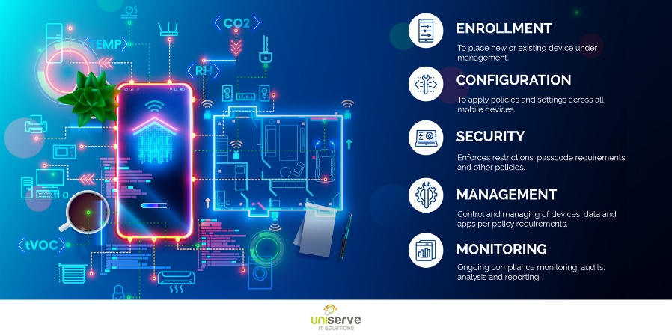
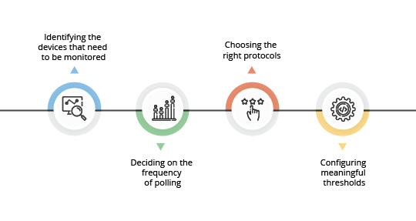
6. Mobile Device Management Policy: Establishing security protocols for mobile devices accessing the network, such as requiring device encryption, remote wipe capabilities, and secure connectivity measures. 7. Network Monitoring Policy: Outlining the procedures and tools to be used for continuous monitoring of network traffic, detecting anomalies, and responding to potential threats or suspicious activities.

Slide 10
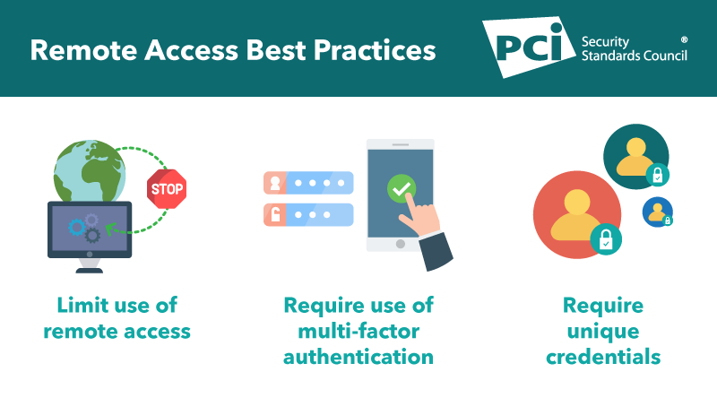
8. Remote Access Policy: Defining the requirements and best practices for secure remote access to the network, including the use of virtual private networks (VPNs) and two-factor authentication.

Slide 11
9. Backup and Disaster Recovery Policy: Specifying the processes for regular data backups, offsite storage, and establishing recovery plans in case of data loss, system failure, or natural disasters. 10. Employee Training and Awareness Policy: Ensuring that all employees undergo regular security training and are aware of their responsibilities regarding network security, including reporting potential risks and maintaining the confidentiality of data.

Slide 12
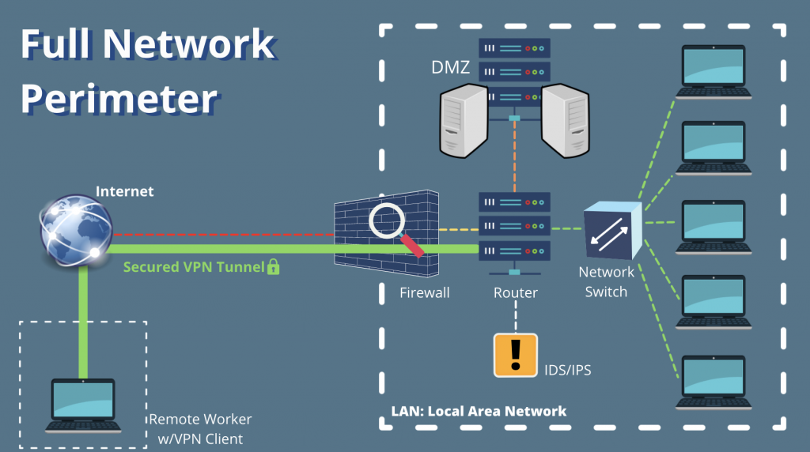
Network perimeter security:
This topic focuses on securing the boundaries of an organization's network, such as firewalls, intrusion prevention systems, and virtual private networks (VPNs)

Slide 13
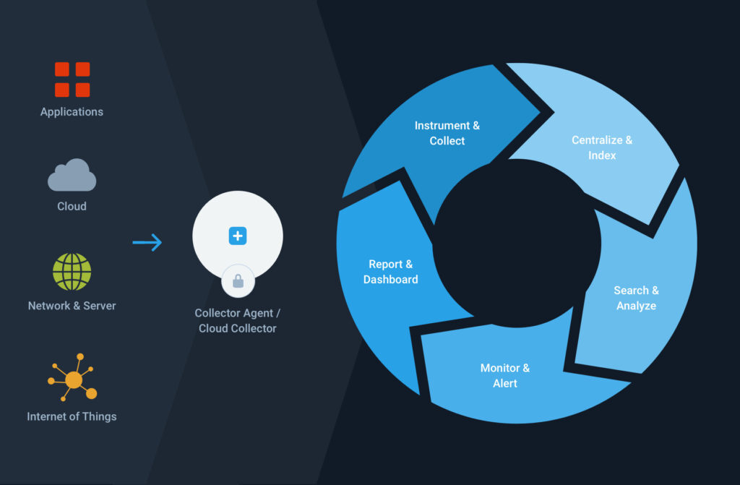
Network monitoring and logging
This topic covers policies related to network monitoring, log collection, and analysis to detect suspicious activities and potential security breaches.

Slide 14
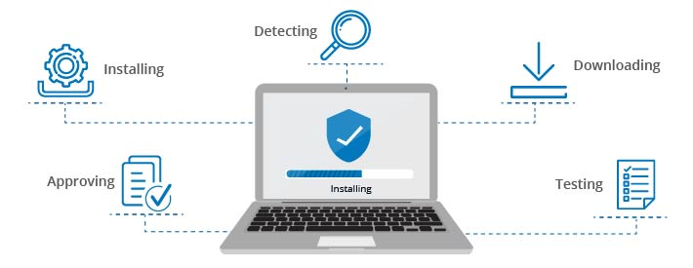
Patch management:
This topic includes policies for regularly updating and patching software and firmware on network devices to address security vulnerabilities.

Slide 15
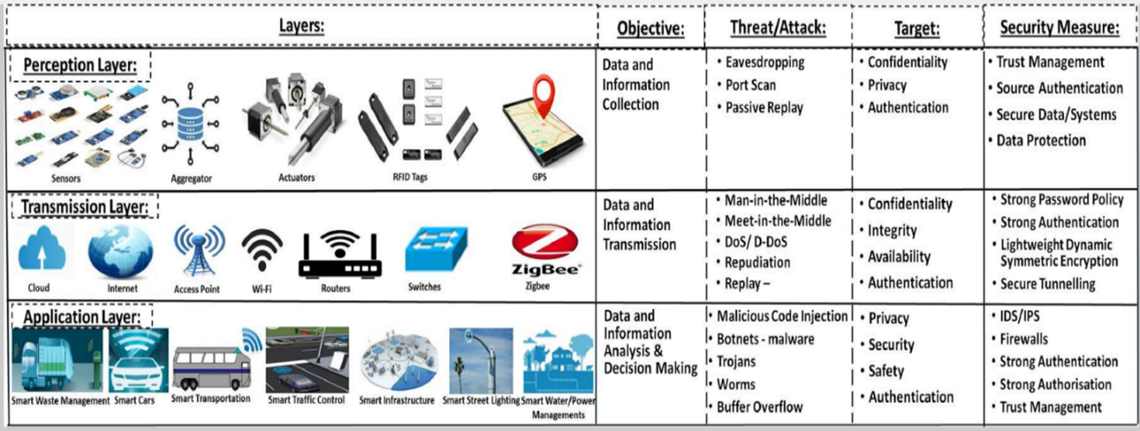
Physical security:
This policy addresses the physical protection of network infrastructure, such as data centers, server rooms, and network equipment, to prevent unauthorized access or tampering.

Slide 16

John the Ripper
John the Ripper is a widely used password cracking tool that is designed to help assess the strength of passwords used in various systems. It is an important tool in the field of network security for several reasons:
Password auditing: John the Ripper helps administrators and security professionals identify weak or easily guessable passwords within their networks. By testing the strength of passwords, it highlights vulnerabilities and enables organizations to enforce stronger password policies.

Slide 17
2. Vulnerability assessment: Passwords serve as a common entry point for attackers attempting to gain unauthorized access to systems. By identifying weak passwords, John the Ripper assists in identifying potential vulnerabilities in network security and allows for appropriate measures to be taken to mitigate them.
3. Penetration testing: Organizations often use John the Ripper during penetration testing exercises to simulate real-world attack scenarios. By attempting to crack passwords, it can determine the effectiveness of an organization's password security measures and help identify areas of improvement.

Slide 18
4. Password recovery: John the Ripper can also be used for legitimate purposes, such as recovering lost or forgotten passwords within an organization. This can save time and resources that would otherwise be spent on resetting passwords or accessing locked accounts.
5. Research and education: John the Ripper has been an essential tool for researchers and security professionals interested in understanding password security and improving password cracking techniques. Its availability and use contribute to the ongoing development of stronger password protection methods.
It is important to note that while John the Ripper can be a valuable tool in network security, it should only be used by authorized individuals with proper consent and in compliance with relevant laws and regulations.

Slide 19
Thank You…!!!

